Slide 1
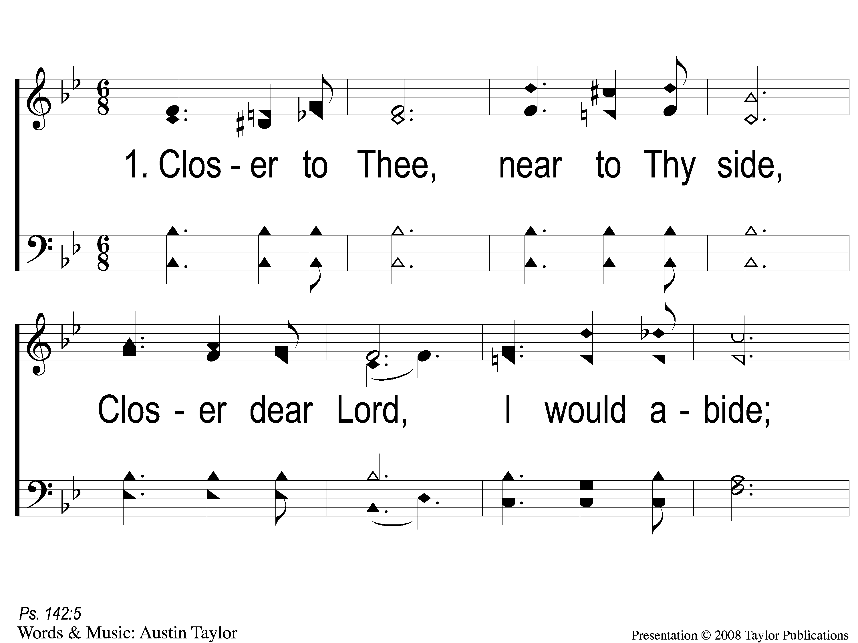
1-1 Closer to Thee
Closer to Thee
92

Slide 2
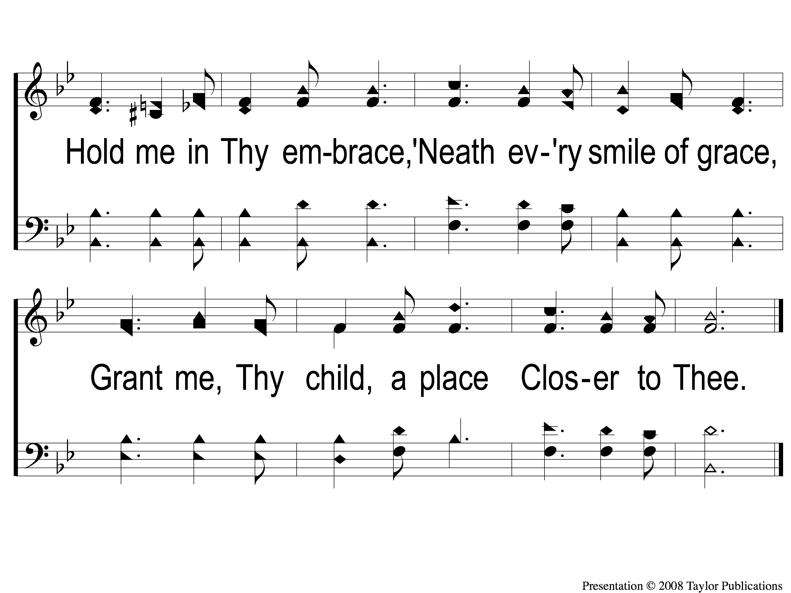
1-2 Closer to Thee
Closer to Thee
92

Slide 3
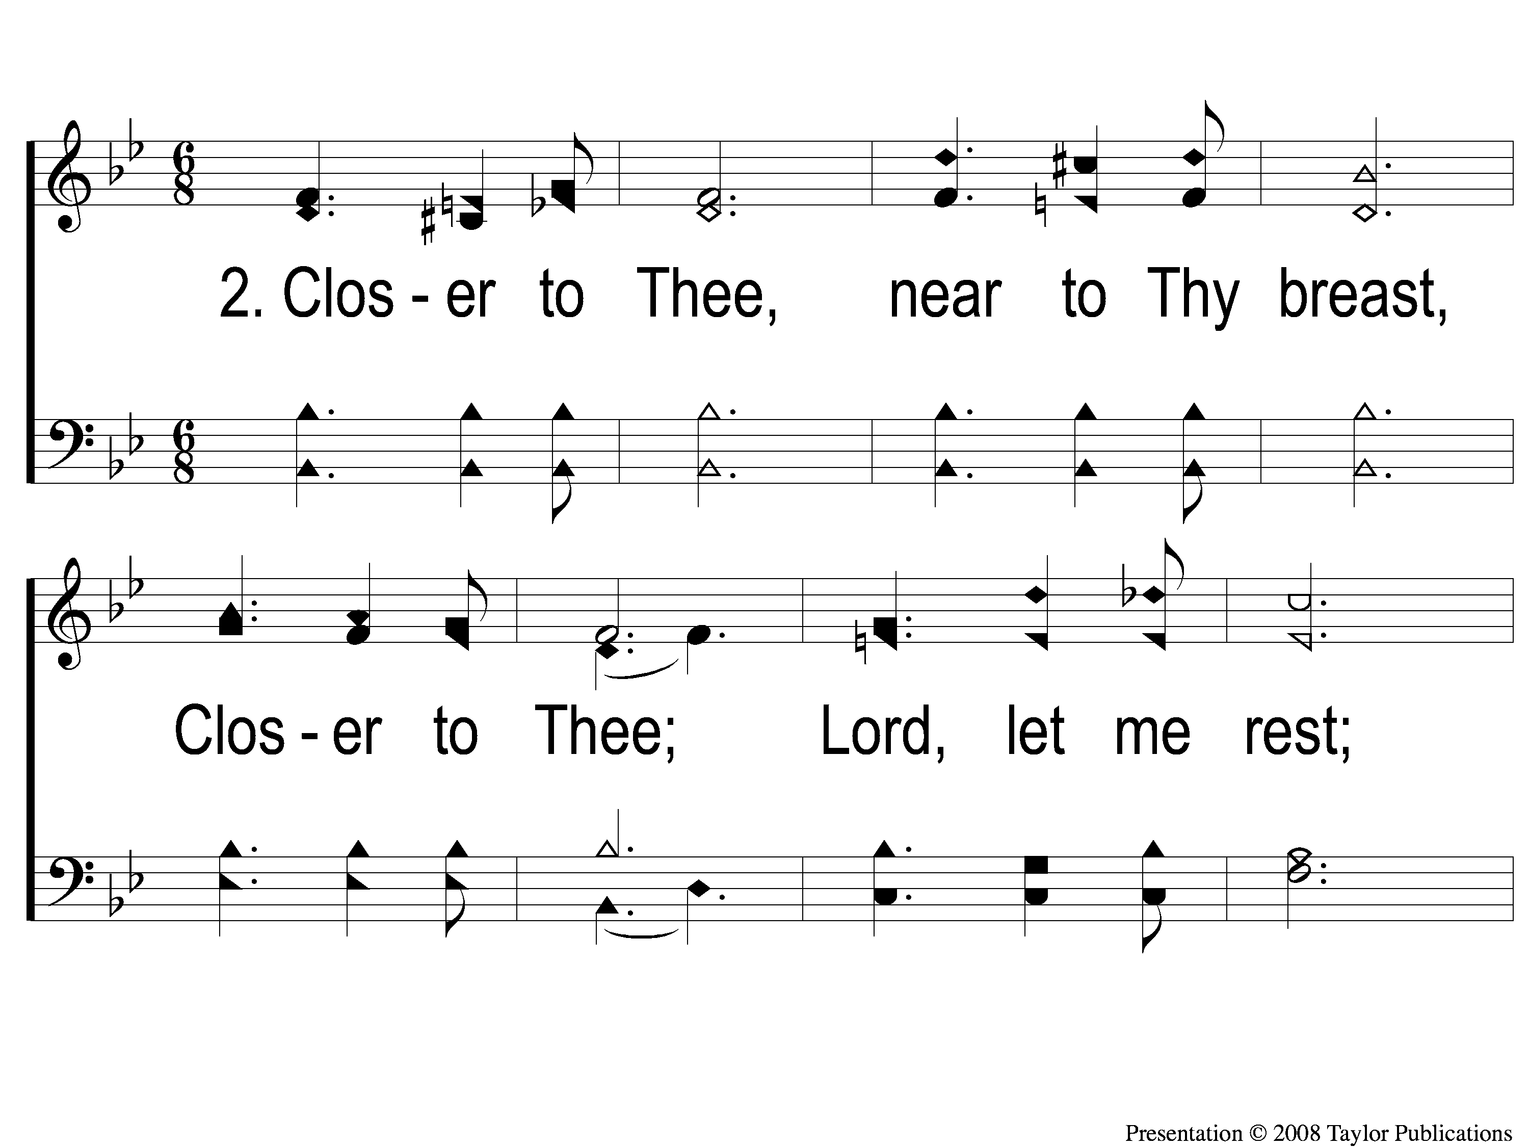
2-1 Closer to Thee
Closer to Thee
92

Slide 4
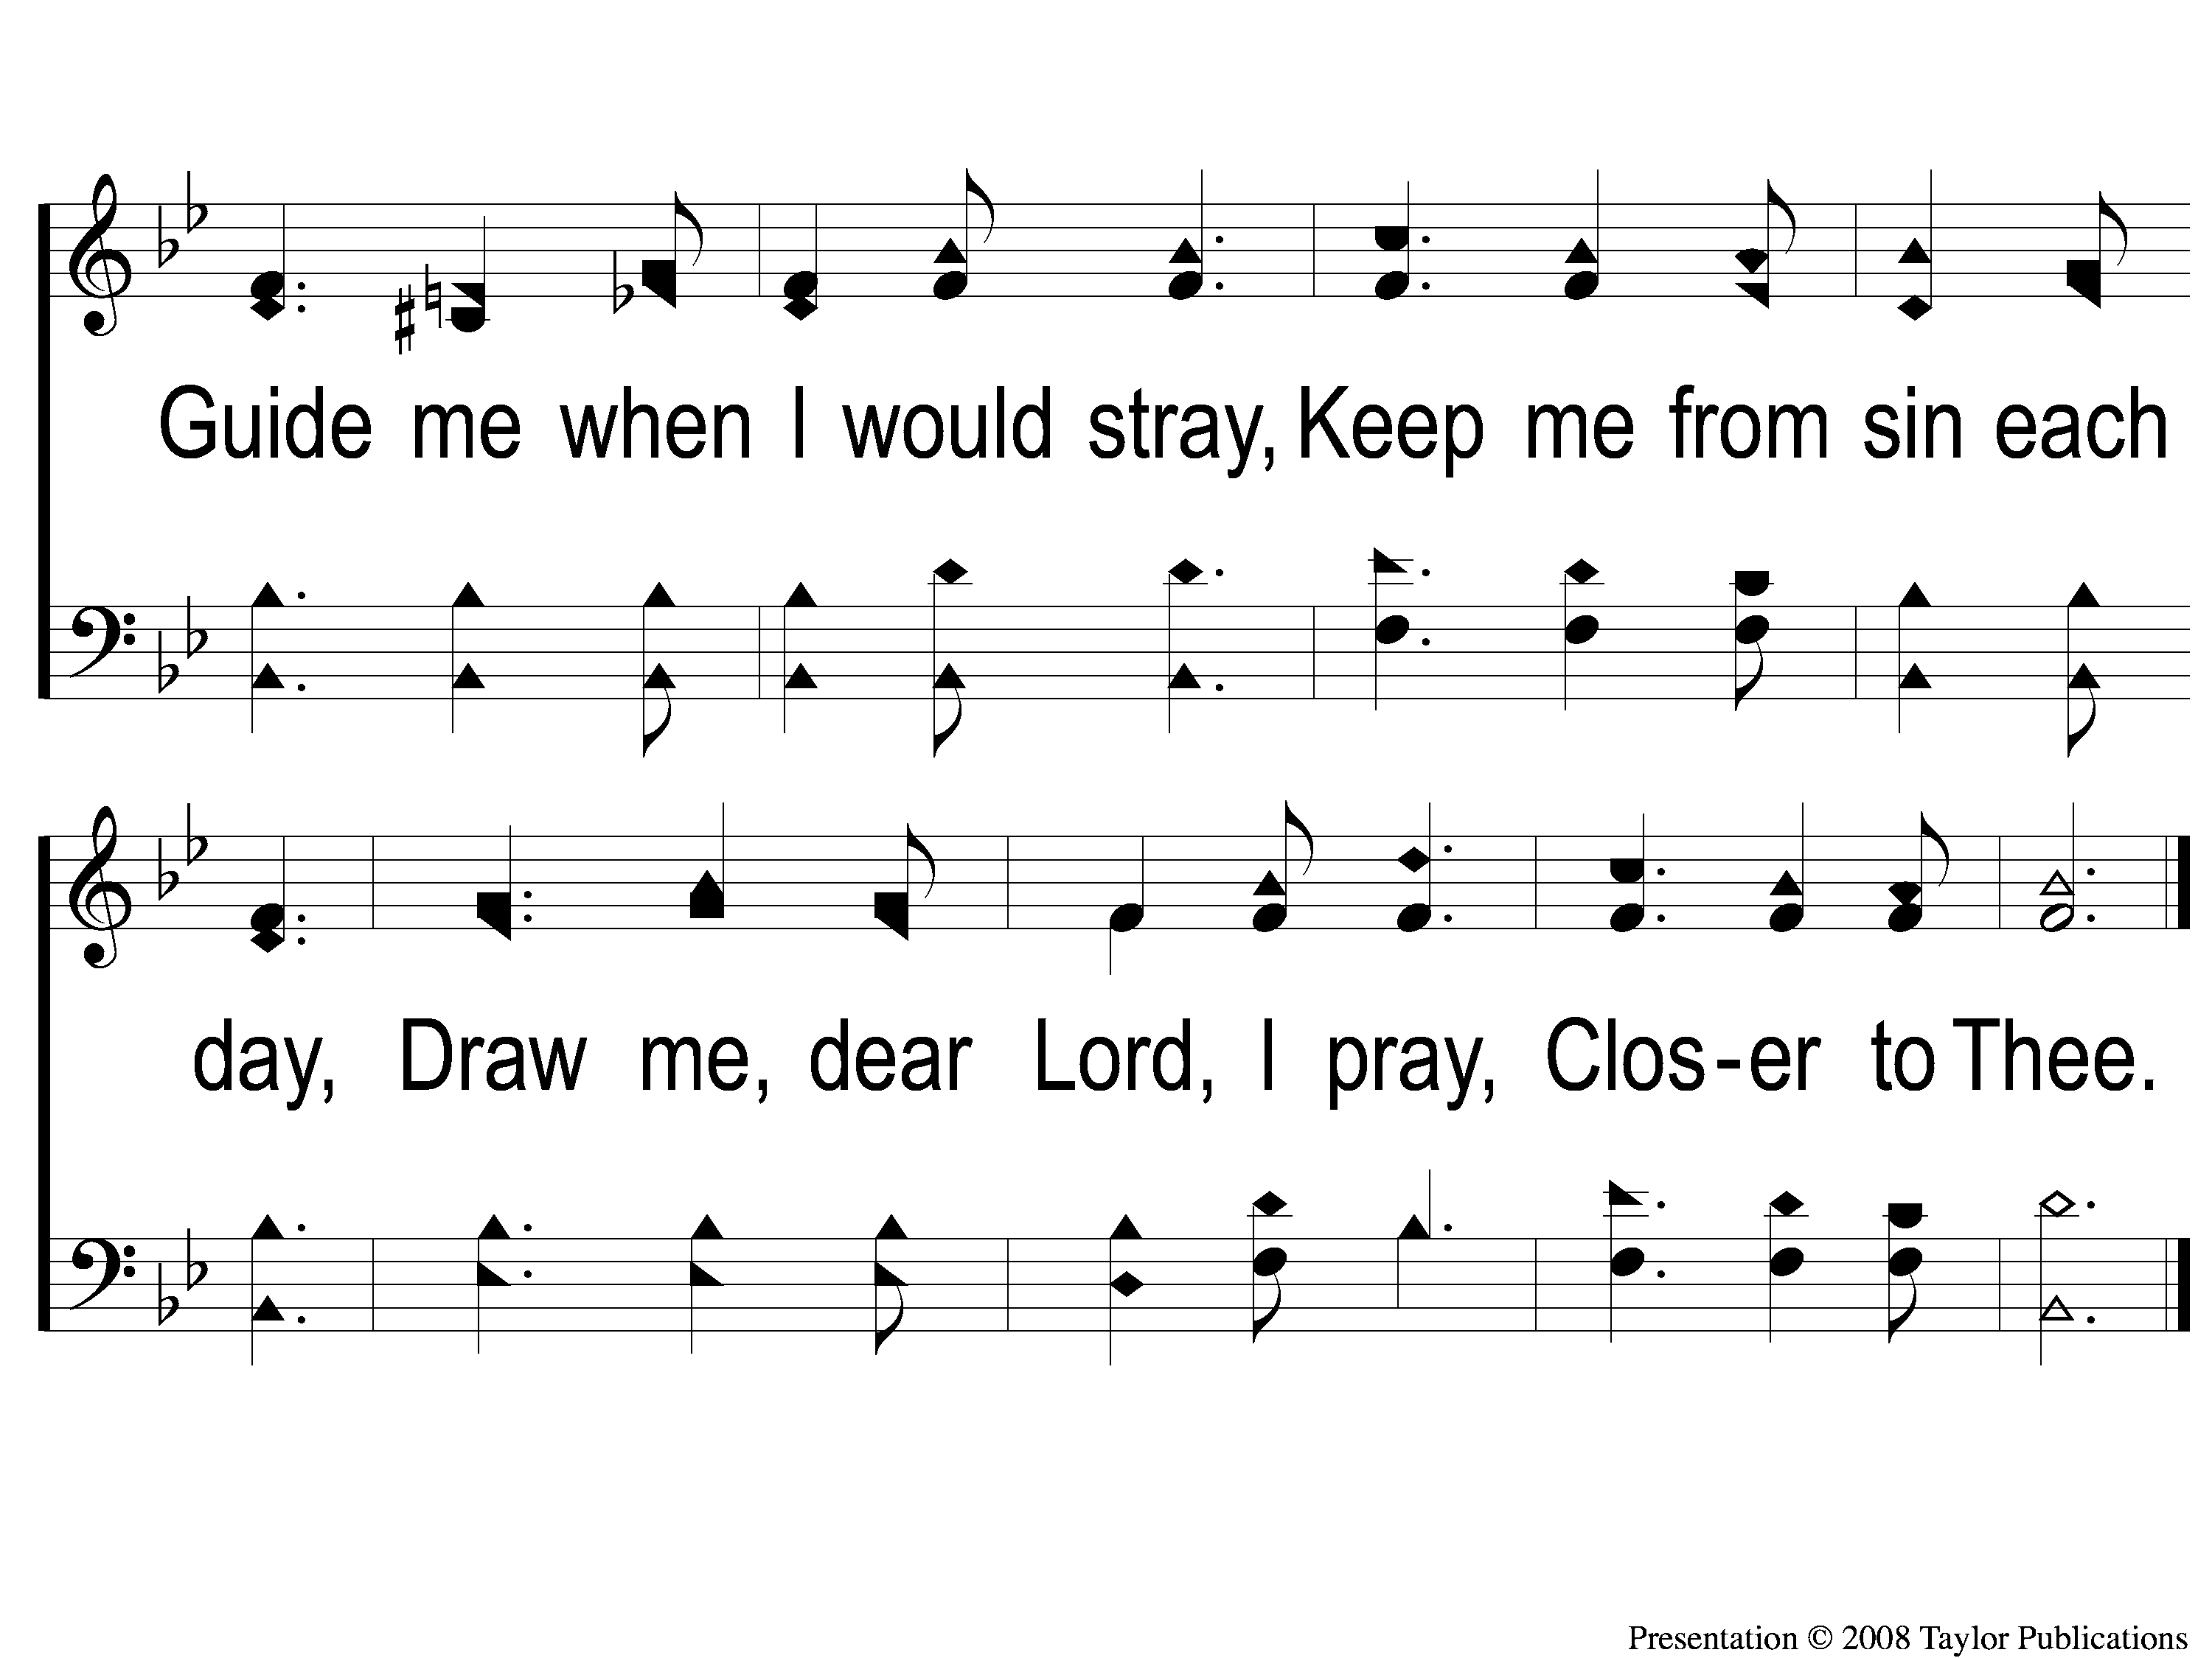
2-2 Closer to Thee
Closer to Thee
92

Slide 5
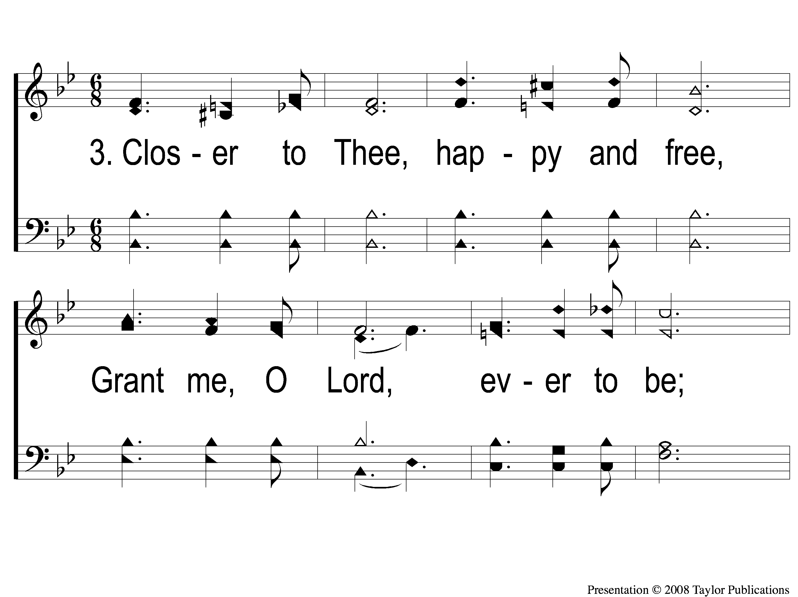
3-1 Closer to Thee
Closer to Thee
92

Slide 6
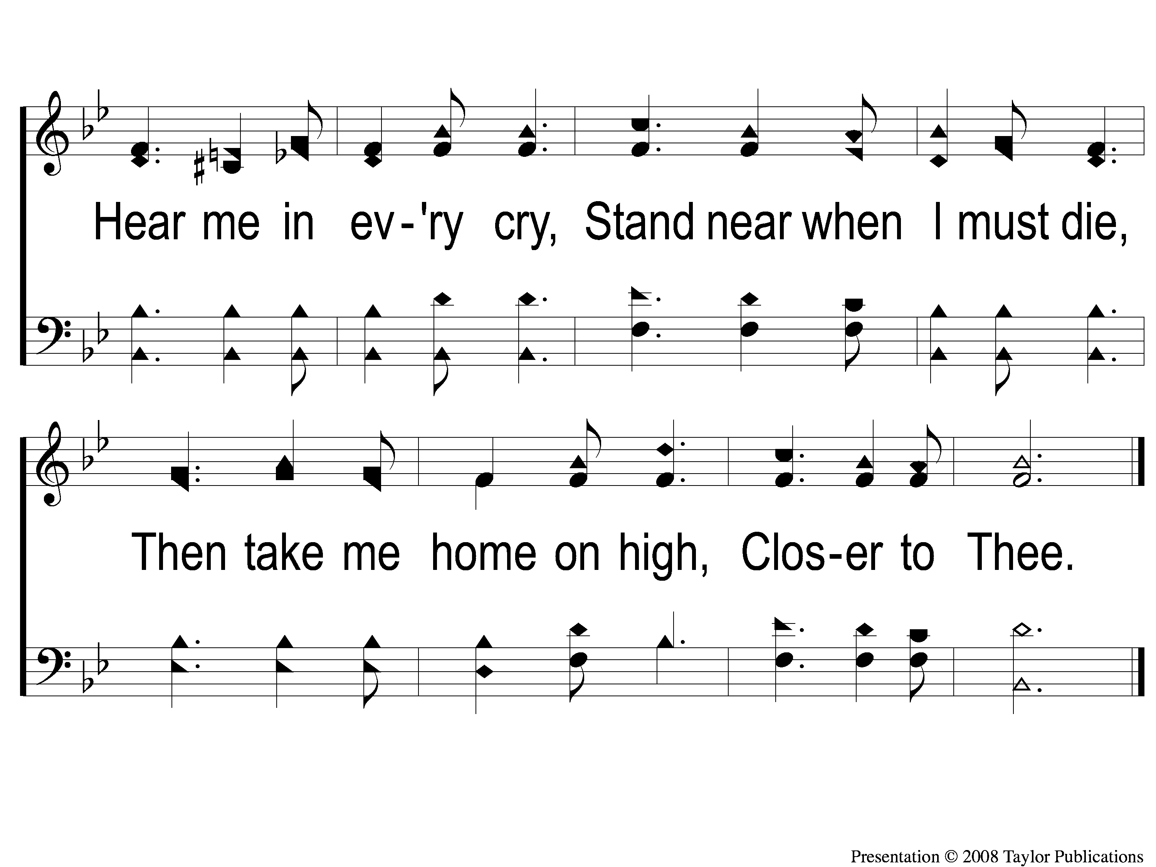
3-2 Closer to Thee
Closer to Thee
92

